Slide 1
SALES PRESENTATION

Slide 2
SALES PRESENTATION

Slide 3
PORTFOLIO OF MARKETING RESOURCES
Display + Email Marketing
Content Marketing
Lead Generation
Live + Online Events
Thought leadership
Conference + Expo
eSummits
Executive Roundtables
Custom Event Production
Invitation-Only Business Summits (Spring and Fall)
Regional invitation-Only Events for CISOs
Confidential | Page 3

Slide 4
STRATEGY
BUILD A MULTI-PLATFORM BUSINESS
Digital Content and Marketing Services
Conferences, Webinars and Invitation-only Events
Peer Based Membership
Research, Data and Time Sensitive Business Intel
Education, Certification, and Leadership Development
Security Awareness
Serve high quality distinctive content to drive deep audience engagement, while connecting the community to leading technology and service providers
Produce exclusive events and other specialized services to increase professional intelligence and networking
Curate community discussion to enable learning, networking and sharing of best practices among an “inner circle” of top industry leaders
Deliver benchmark data and other critical information to senior-level decision makers across industries
Provide leading continuing education and certification programs for industry practitioners
Enterprise-wide security assessments and programs designed to raise employee awareness and provide a frontline defense
Capabilities
Unify leading brands – the best of breed companies – in every platform category
Accrue market perspective and intellectual leverage as we grow
Leadership is comprised of a collaborative team of deeply experienced operators, entrepreneurs and investors
CyberRisk Alliance is positioned to provide the highest quality product and disrupt the marketplace by assembling a unique and diversified portfolio of services
Confidential | Page 4

Slide 5
MARKET CHARACTERISTICS
Unprecedented cybercriminal activity is of critical importance to our national and global security and economic stability
Worldwide spending on cybersecurity products and services is projected to grow steadily in the coming years
Fraught with threats, the current environment is putting increased pressure on large corporations across all industry sectors, government agencies, healthcare organizations, financial and academic institutions
Cybersecurity and information risk management professionals, corporate officers and board members that govern the risk and compliance processes have an increasingly high demand for information
The market’s rapid evolution has led to a proliferation of technology and product innovation
Confidential | Page 5

Slide 6
VISION
Build a powerful market-leading business intelligence company designed to serve our high-growth, rapidly evolving industry with a diversified portfolio of services that inform, educate, build community
and facilitate commerce.
Confidential | Page 6

Slide 7
INTEGRATED DEMAND
THOUGHT LEADERSHIP
Native content to further engage community and build brand credibility
BRAND AWARENESS
Digital advertising on SC’s website
with 6M annual page views
LEAD GENERATION
Content downloads and virtual events from SC’s engaged cybersecurity pro audience
CONTENT DEVELOPMENT
High value report derived from research to
Engage targeted IT security professionals
PRIMARY
RESEARCH
In-depth actionable custom research to gather pressing needs from SC’s engaged audience of cybersecurity pros
Confidential | Page 7

Slide 8
PRIMARY RESEARCH
SHIFTING MSSP TO MDR MARKET
Our B2B research capability is built on our proprietary, qualified communities and deep sector expertise.
Full service primary research to meet your objectives
Experienced team of researchers with a collaborative approach, enhanced by deep subject matter expertise
Custom studies and analytics at all levels of complexity
Actionable insights and comprehensive reports
Highly qualified and engaged respondents sourced from our experienced and diverse audience
RESEARCH
COMPETENCY
AUTHORITATIVE
MARKET EXPERIENCE
LARGE COMMUNITIES OF ENGAGED, INFLUENCIAL, DECISION MAKERS
Confidential | Page 8

Slide 9
CUSTOM PRIMARY MARKET RESEARCH
GUIDES STRATEGIC DECISIONS AND
THOUGHT LEADERSHIP CONTENT
BUSINESS/MARKETING STRATEGY SUPPORT
THOUGHT LEADERSHIP CONTENT
Brand management
Whitepapers/eBooks
Project management
Web Seminars
CUSTOM MARKET RESEARCH
Customer Needs
Infographics
Market Assessment
Social Media/Blogs
Confidential | Page 9

Slide 10
INDUSTRY VOICE RESEARCH PROGRAM
GUIDES STRATEGIC DECISIONS AND
THOUGHT LEADERSHIP CONTENT
10-question survey
50 pre-screened cybersecurity executives
Executive Summary presentation delivered on a one-hour call
RESEARCH - ONLY
White paper/eBook (8-10 pages)
3 Twitter card graphics
Press release announcing key research highlights (wire and CRA newsfeed)
RESEARCH + THOUGHT LEADERSHIP CONTENT
Confidential | Page 10

Slide 11
BUYER AND INFLUCENCER RESEARCH PROGRAM
GUIDES STRATEGIC DECISIONS AND
THOUGHT LEADERSHIP CONTENT
25-question survey
300 cybersecurity solutions buyers and influencers
Executive Summary presentation delivered on a one-hour call
Tabulated data file with cuts
RESEARCH - ONLY
White paper/eBook (8-10 pages)
3 freestanding infographics
Press release announcing key research highlights (wire and CRA newsfeed)
RESEARCH + THOUGHT LEADERSHIP CONTENT
Confidential | Page 11

Slide 12
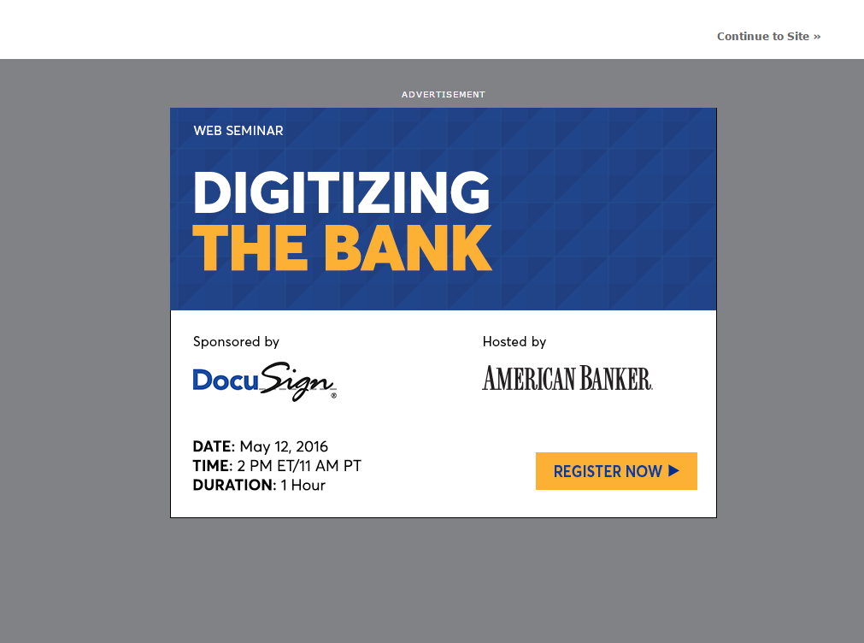
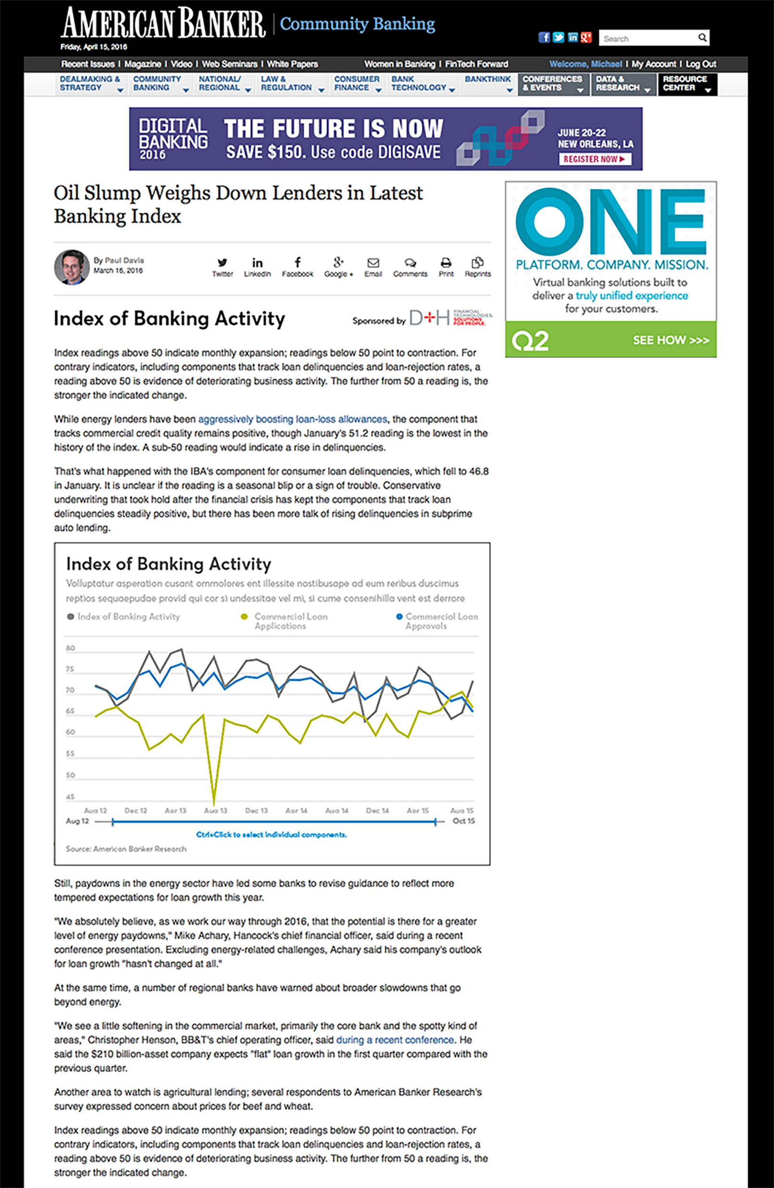
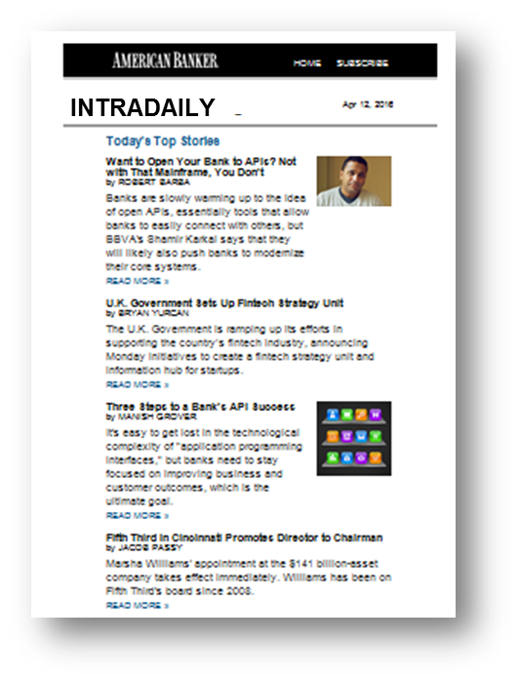
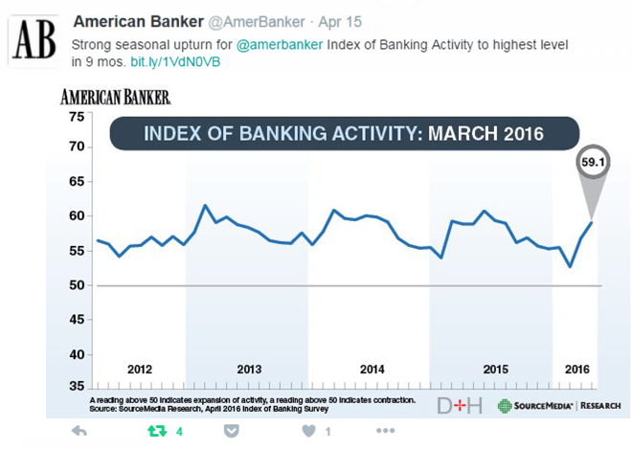
BUSINESS ACTIVITY RESEARCH PROGRAM
GENERATE BUZZ AND ENGAGEMENT WHILE
PROMOTING THE SPONSOR AS AN INDUSTRY THOUGHT LEADER
CO-BRANDED DIGITAL PROMOTIONS
High impact branding will promote sponsor’s brand and thought leadership by promoting the Index content.
HOME PAGE PROMOTIONS
Premium promotions on the front page of the SC website.
PRESS RELEASES
Distributed to all the major search engines (Google, Yahoo and Bing) and major news sites, bloggers and journalists.
BUSINESS ACTIVITY INDEX
The index is a composite of multiple cybersecurity activities, constructed to reveal and track progress to help understand and anticipate key trends in the market.
EMAIL PROMOTION
One of our most effective traffic drivers, our newsletter ads will sit within the content well of our daily newsletters and drive traffic on a rotating schedule to all of the sponsored index articles.
SOCIAL MEDIA PROMOTIONS
To increase social engagement and spark conversation, SC will post the index results through social postings
*Mocks for illustrative representation only. Actual content and sponsorship design and layout are subject to change.
Confidential | Page 12

Slide 13
CUSTOM RESEARCH STUDIES AND TRACKERS
RESEARCH AND ANALYSIS TO GUIDE
YOUR BUSINESS AND MARKETING DECISIONS
BRAND MANAGEMENT STUDIES
CUSTOMER NEEDS STUDIES
Brand awareness
Key purchase drivers
Buyer journey
Competitive positioning
Segmentation analysis
Persona profiling
Voice of the customer
Customer satisfaction
Loyalty/retention
PRODUCT MANAGEMENT STUDIES
MARKETING ASSESSMENT STUDIES
Current state/environment assessment (challenges and pain points); need for change
Future state/environment assessment (readiness for change, key purchase drivers, upgrades, spending, adoption barriers, etc.)
New product or concept test
Feature prioritization
Perceptual mapping
Confidential | Page 13

Slide 14
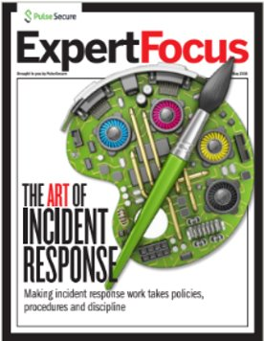
CONTENT DEVELOPMENT
SHIFTING MSSP TO MDR MARKET
High value content using research data and written by SC Media and CRA’s market experts to engage your target audience segments
Reports
Infographics
Briefing sheets
Sales data collateral
Webinars
Confidential | Page 14

Slide 15
LEAD GENERATION
SHIFTING MSSP TO MDR MARKET
Multiple tactics to drive high levels of engagement with target audience segments and fill pipeline
Content Syndication – using newly created research-based assets and existing Trustwave assets
Standard – earlier funnel leads
HQL – warmer leads Virtual Events
April 29-30 Healthcare Cybersecurity
June 17 – Identity and Access Management Webinars
Conversational interview formats
Trustwave provided content formats
ATTRACT
ENGAGE
NURTURE
CONVERT
Confidential | Page 15

Slide 16
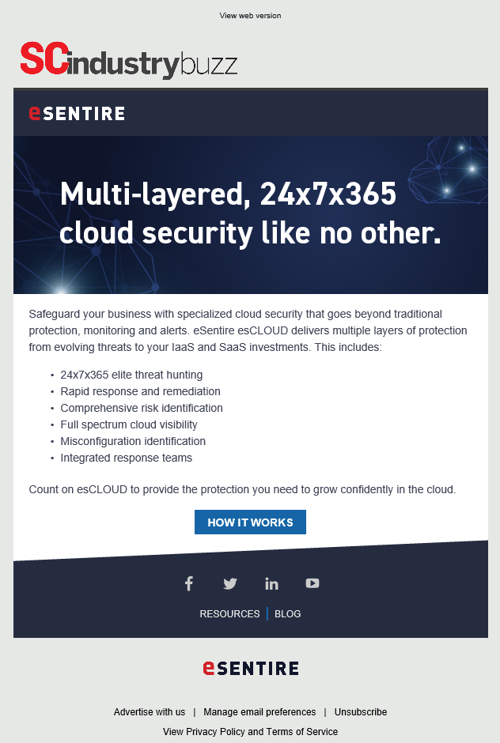
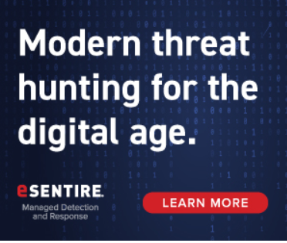
BRAND AWARENESS AND THOUGHT LEADERSHIP
SHIFTING MSSP TO MDR MARKET
Digital marketing with SC Media
Native Content TechSCAPE program – post your blogs, video, infographics, etc. on SCmagainze.com
Promote Trustwave brand and messaging on Scmagazine.com
Retarget across the web
Email Trustwave news and events directly into SC’s audience inboxes
Confidential | Page 16

Slide 17
INTEGRATED DEMAND CAMPAIGN
PROGRAM | TIMING/CAPABILITY | OVERVIEW | METRIC | NET COST
Research – Buyers & Influencers Study | 8 weeks Primary Research | In-depth, actionable insights examining essential issues and challenges confronting cybersecurity pros, 25-questions online survey | ~300 prescreened cybersecurity solutions buyers and influencer respondents Executive summary presentation 60-minute conference call Tabulated data | $35,000
Research Report Content Creation | 4-6 weeks – June Content development | Develop 8-10pp whitepaper report based on the research findings and SC/CRA market knowledge | 8-10 page whitepaper report | $15,000
Content Syndication | ~12 weeks – June to Sept Lead Generation | Syndication whitepaper research report to target cybersecurity pro audience | 500 guaranteed leads from 1,000+ company size only | $40,000
Virtual Event | March 26 or April 29 Lead generation | Booth and speaking session at phishing, ransomware, and malware or HC virtual event – gold sponsorship | 400 guaranteed registrants | $16,000
Native Content TechSCAPE | ~12 weeks Thought leadership & Brand awareness | 3 client content pieces posted on SC, premium placement promotions, ads surround content | 50,000 native ad promo impressions | $16,820
TOTALS |  |  | - High value research - Whitepaper research report - 900 leads - 50,000 impressions | $122,820
Confidential | Page 17

Slide 18
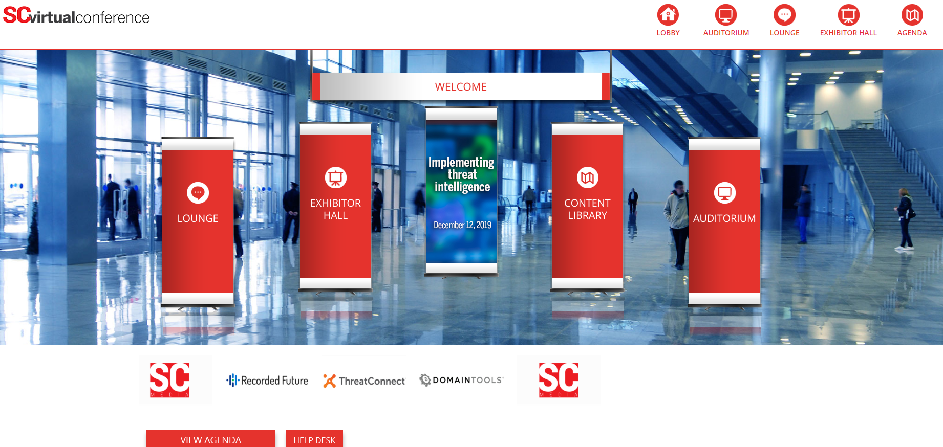
VIRTUAL CONFERENCES
SC Virtual Events provide global access to unique content, cutting-edge insights, and analysis from the SC team and a roster of industry experts.
Attendees gain invaluable knowledge – and CPE credits – all from the convenience of their desktops.
Upcoming SC Virtual Conference Sponsors generate pipeline leads from booth attendees, Q&A, content downloads and speaking sessions.
Cybersecurity in Healthcare – April 29, 2020
Identity and Access Management – June 18, 2020
SC VIRTUAL EVENT SPONSOR PACKAGES
Platinum level: 600 leads, virtual booth in exhibit hall, 30-minute speaking session, ability to host 3 assets ($21,000)
Gold level: 400 leads, virtual booth in exhibit hall, 30-minute speaking session, ability to host 2 assets ($16,000)
Silver level: 225 leads, virtual booth in exhibit hall, ability to host 2 assets ($10,125)
Confidential | Page 18
This Photo by Unknown Author is licensed under CC BY-SA

Slide 19
WEBCASTS
 | EDITORIAL WEBCASTS |  | VENDOR WEBCASTS
 | Edit Webcast | 20/20 Webcast | Vendor Webcast | DemoCast
Format | Keynote-style presentation with 5-min sponsor presentation | Interview-style, Conversation with sponsor SME | Thought leadership presentation with audio and slides | Thought leadership presentation with product demonstration
Duration | 60 min | 30 min | 60 min | 30 min
Audience Q&A | Yes | Time permitting | Yes | Yes
Content | Editorially driven on sponsor selected topic | Editorially driven on sponsor selected topic | Sponsor driven | Sponsor driven
SC edit moderation | Yes | Yes | Yes | Yes
Speakers | SC-recruited industry expert feat. sponsor SME | SC editor and sponsor SME | Sponsor arranged | Sponsor arranged
Additional info | Industry expert presents, followed by 5-minute presentation from Sponsor | SC editor moderates and participates in conversation with Sponsor SME | SC editor moderates, sponsor provides content/speaker | SC editor moderates, sponsor provides content/speaker
Leads | 175 | 150 | 150 | 150
Cost | $30,000 | $25,000 | $22,000 | $22,000
Confidential | Page 19

Slide 20
TRUSTWAVE INNOVATION. DELIVERED.
MARKETING OBJECTIVES
SC Media and CRA’s diverse portfolio of offerings and market expertise will support Trustwave’s go-to-market strategy by generating high value research coupled with demand generation, thought leadership and brand awareness among key audiences of Trustwave’s buyers with our trusted
information brands and platforms.
This targeted proposal will create a strong brand presence in the market for Trustwave, and showcase Trustwave as a dominant thought leader over the next 12 months.
CAMPAIGN ELEMENTS
Research to garner market intelligence and develop thought leadership
Custom content written by market experts presenting research
Lead generation for tangible outcomes of prospective buyers
Native content to drive credibility and engagement
Virtual event programs for buyer engagement and to showcase insight
Increased brand exposure
Confidential | Page 20
Notes:
Cymatic, as a young company

Slide 21
SALES PRESENTATION

